Slide 1

Blood Pressure Monitor
Presentation
on
by :
Joshua Tochukwu Ohakwere-Eze

Slide 2
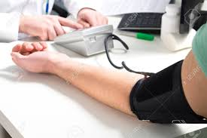
Introduction
Blood Pressure Monitor
Electronic Device
Monitoring Blood Pressure
Instant Health Status
1

Slide 3
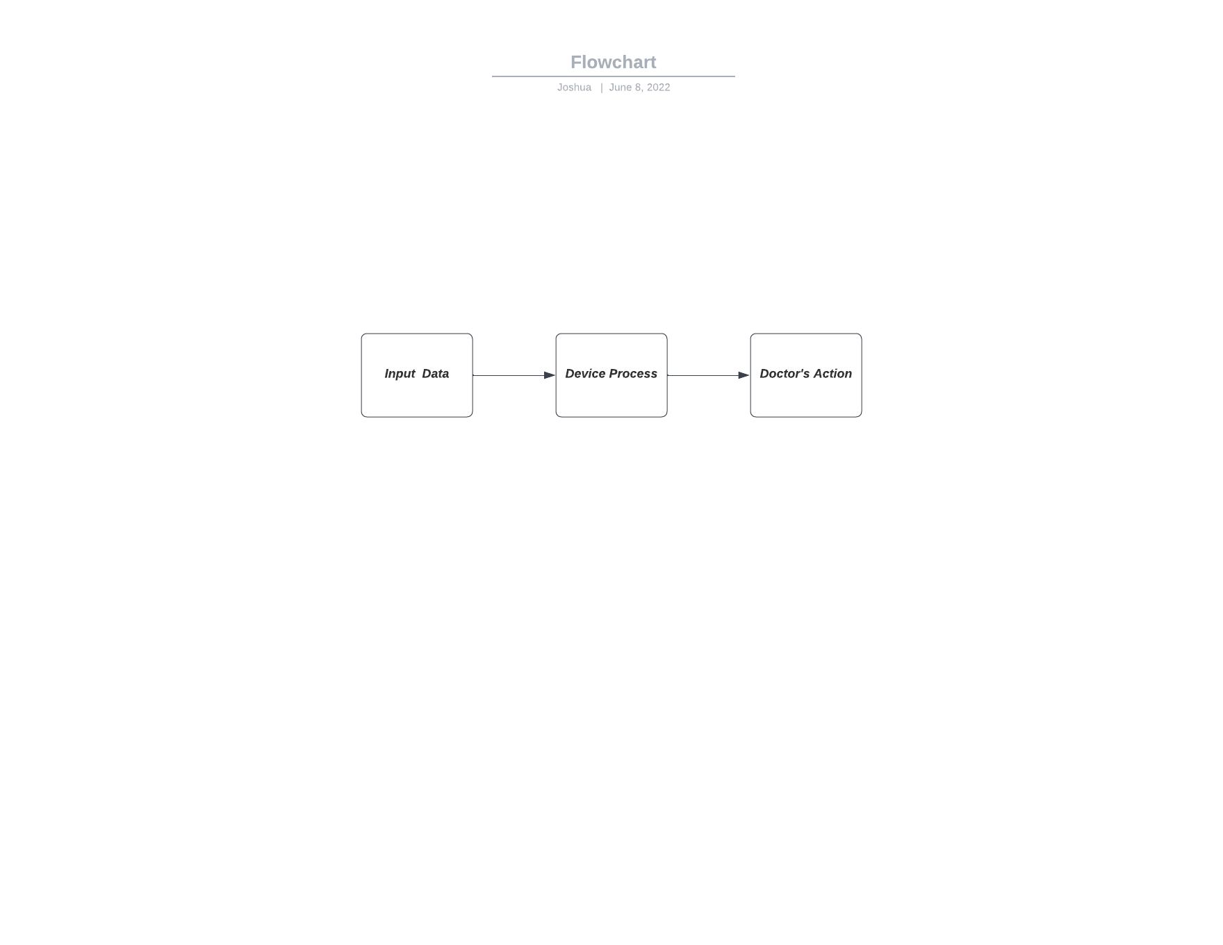
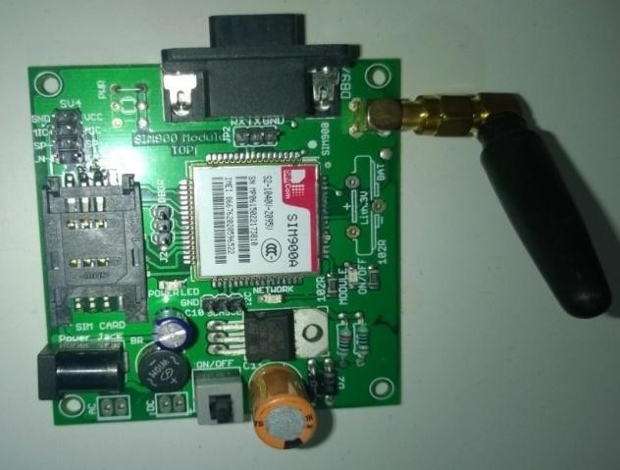
Concept & Motivation
The system includes a device user (in most case is a doctor), the device and a patient.
How can we improve an effective remote communication between patient status and doctor ?
Develop an automatic blood pressure device and enhance its capability by adding Global System for Mobile (GSM) communication component
[3]
2

Slide 4
Requirements for design
Functional: The system shall
Efficiently process vitals collected
Display information based on data received
Alert the operator in the applicable scenario
Send out data to remote location when applicable
Non Functional:
Reliabilty
Usability
Maintenability
Safety
Performance: The system shall
execute commands promptly
operate in real time
3

Slide 5
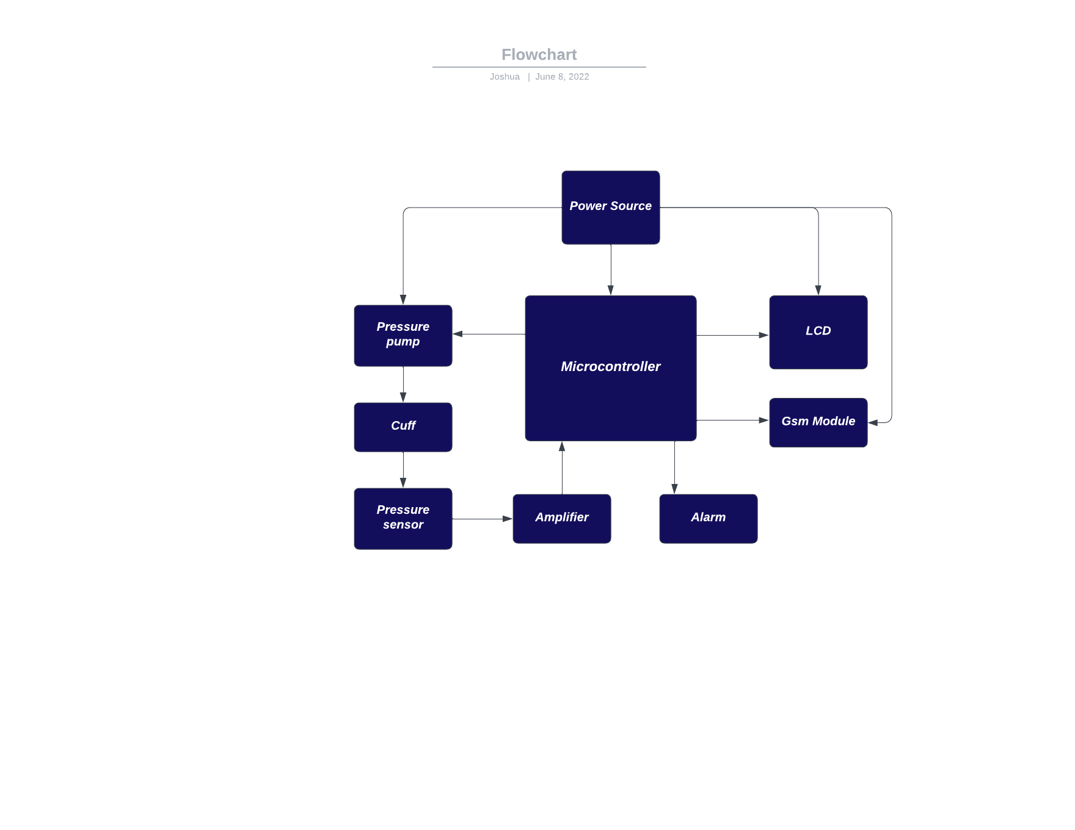
Models for design
4

Slide 6
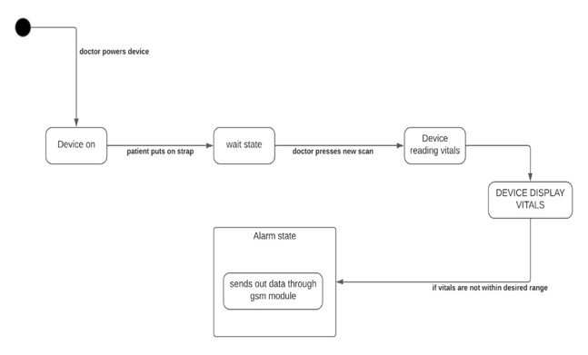
Models for design
5

Slide 7
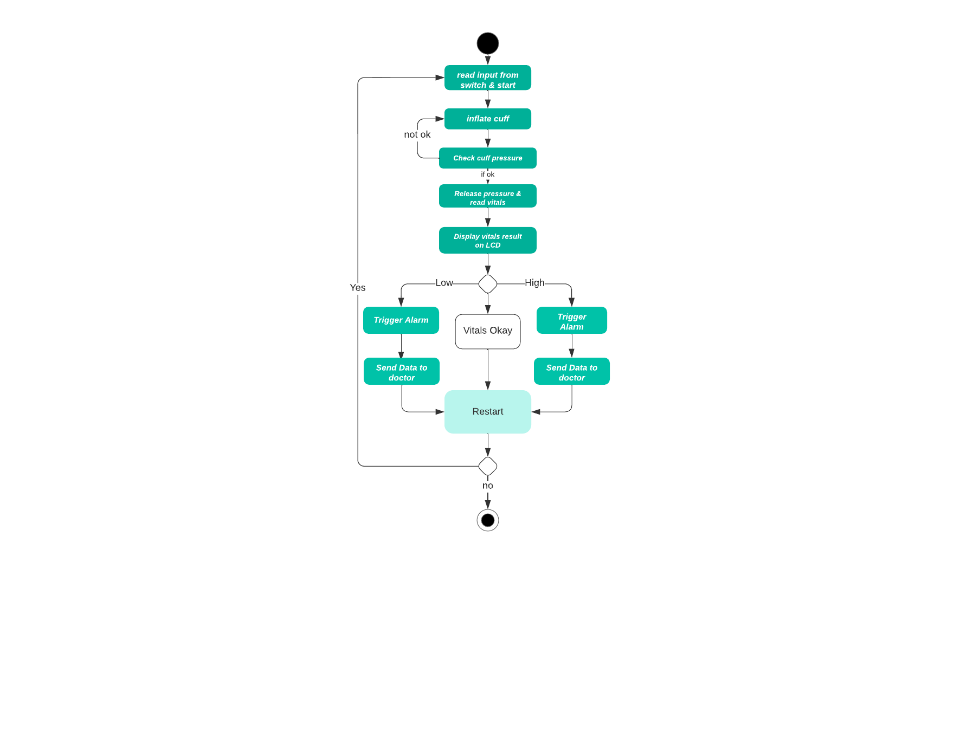
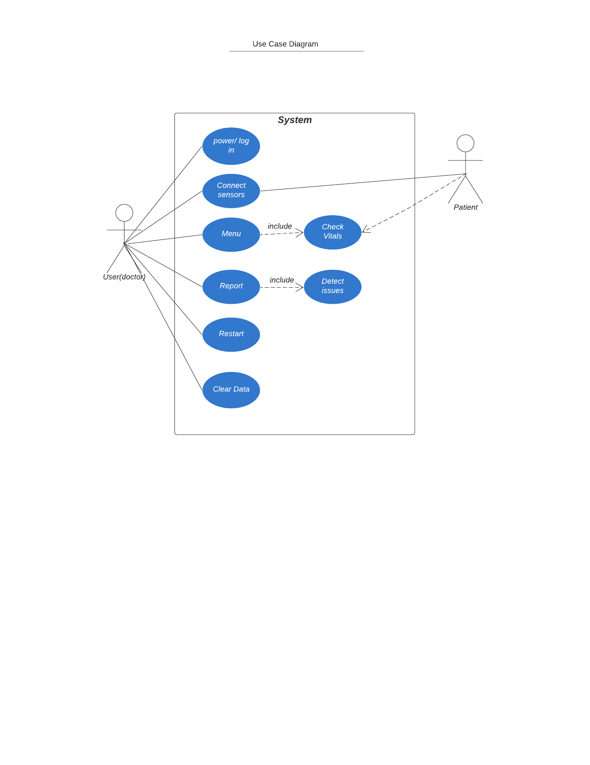
Models for design
[7] Activity Diagram
6

Slide 8
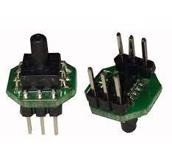
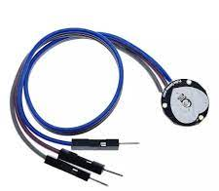
Hardware Components
[9]Pulse Sensor
7

Slide 9
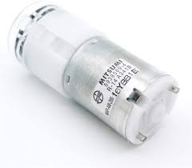
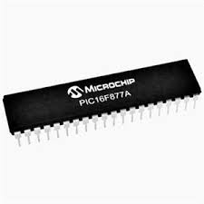
Hardware Components
[11] Microcontroller
8

Slide 10
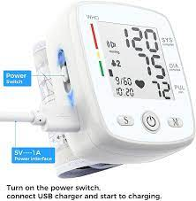
Hardware Components
[13] GSM modem
9

Slide 11
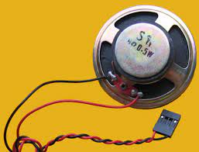
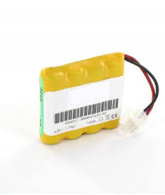
Hardware Components
[15] Battery
10

Slide 12
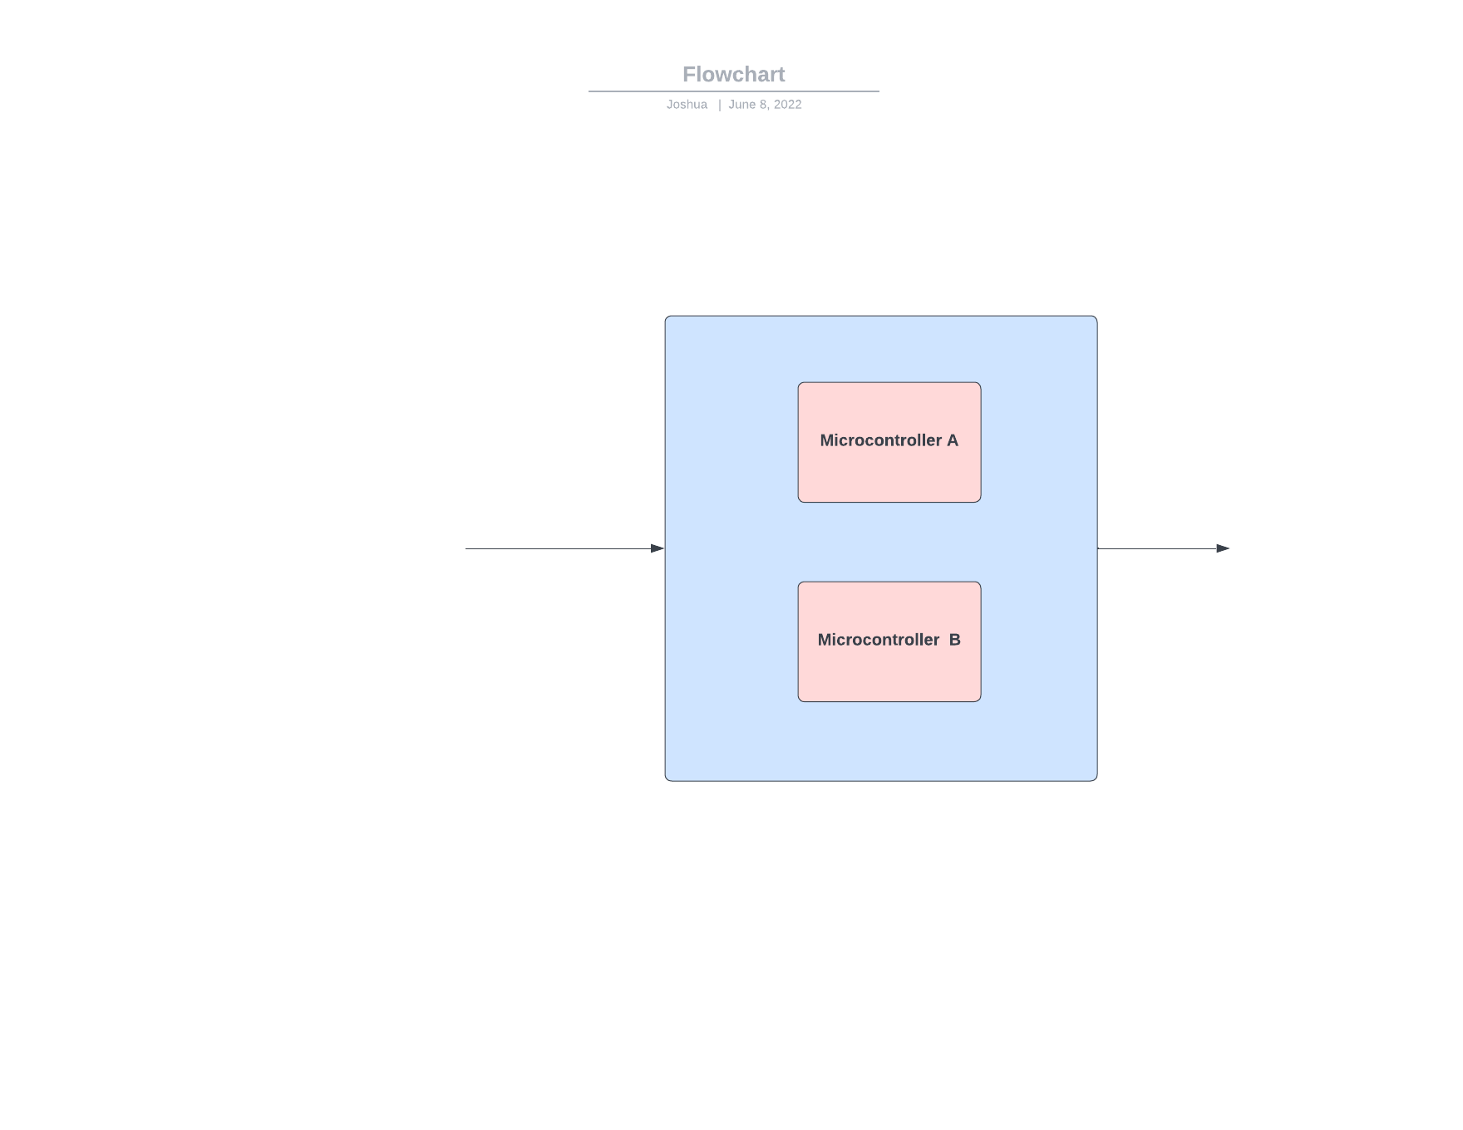
Critical-based Part Of The System
Fail-safe Considerations:
Double Microcontroller Integration
Alternative power source
11

Slide 13
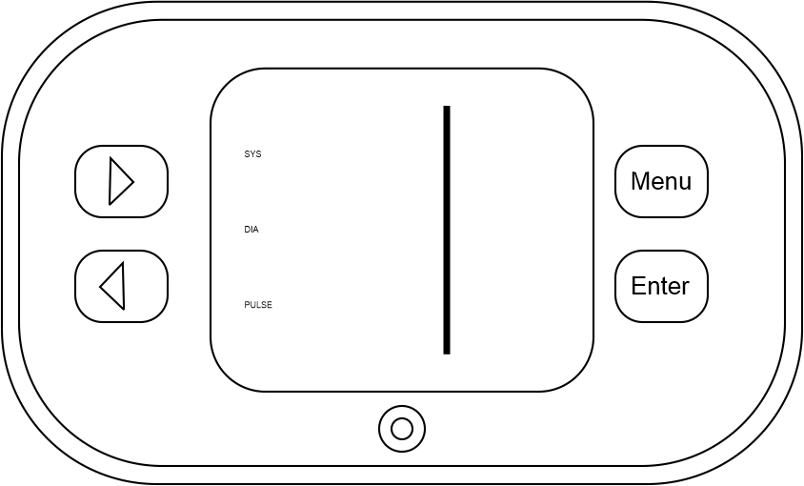
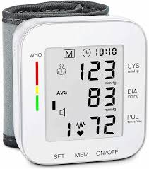
User Interface
[18] Display information
12

Slide 14
Conclusion And Future Work
Microcontroller based fully-automatic blood pressure monitor with GSM communication system allows health personnel to monitor a patient’s BP and heart rate from a remote location without requiring the physician to be physically present to take the measurements. Therefore, this proposed system can be practically used for remote monitoring of the patient blood pressure. The current implementation can be further improved. Future improvements to the system may include; a real time clock so that the date and time of recording can be sent along with the data and a keypad to change the recipient number when desired
13

Slide 15


